Slide 1
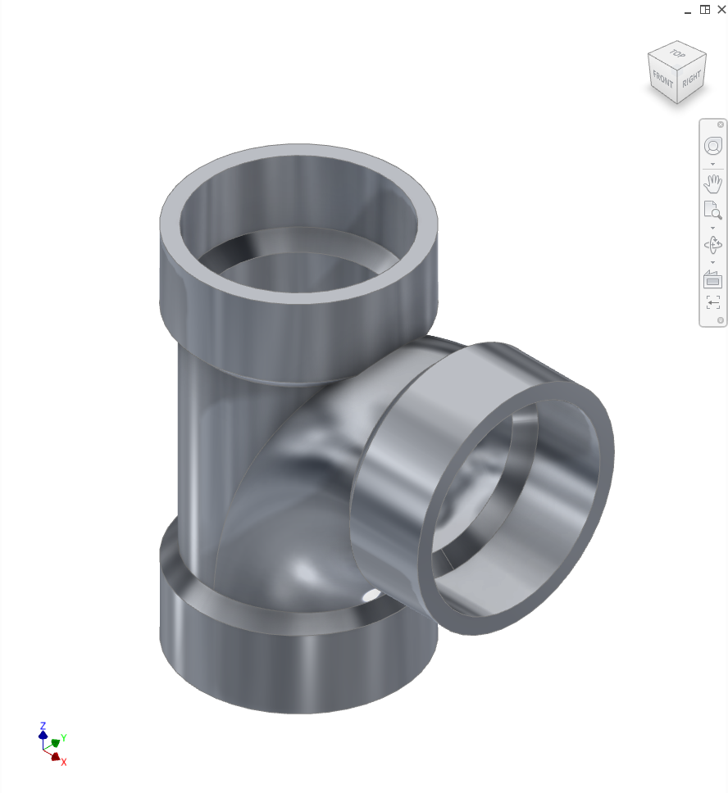
Modelling exercise: sanitary tee
With Autodesk® Inventor® Professional 2023
EN

Slide 2
Task:
Source: Resilient Modeling Strategy
by Richard Gebhard
https://www.resilientmodeling.net/

Slide 3
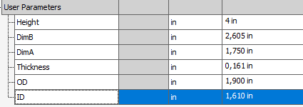
Step 1: Definition of user parameters
(Not absolutely necessary)

Slide 4
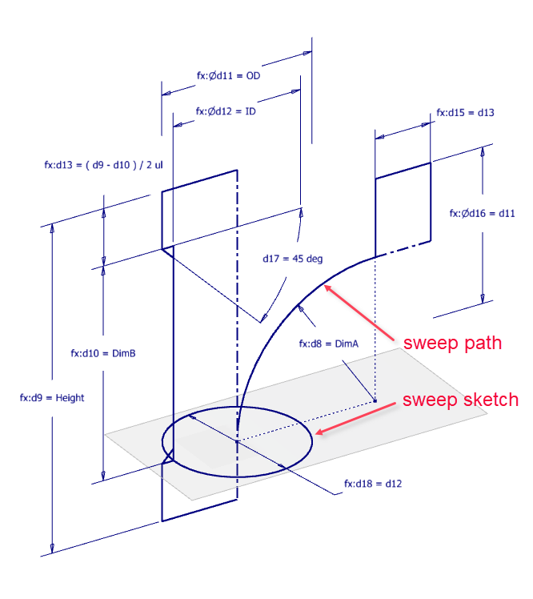
Step 2: Definition of the design intent
1st sketch for tube, socket and sweep path.
2nd sketch for sweep sketch
Note: The lower plane between OD and ID is the sketch plane for the sweep sketch, as well as for the center of the sweep path.
1st sketch is reused

Slide 5
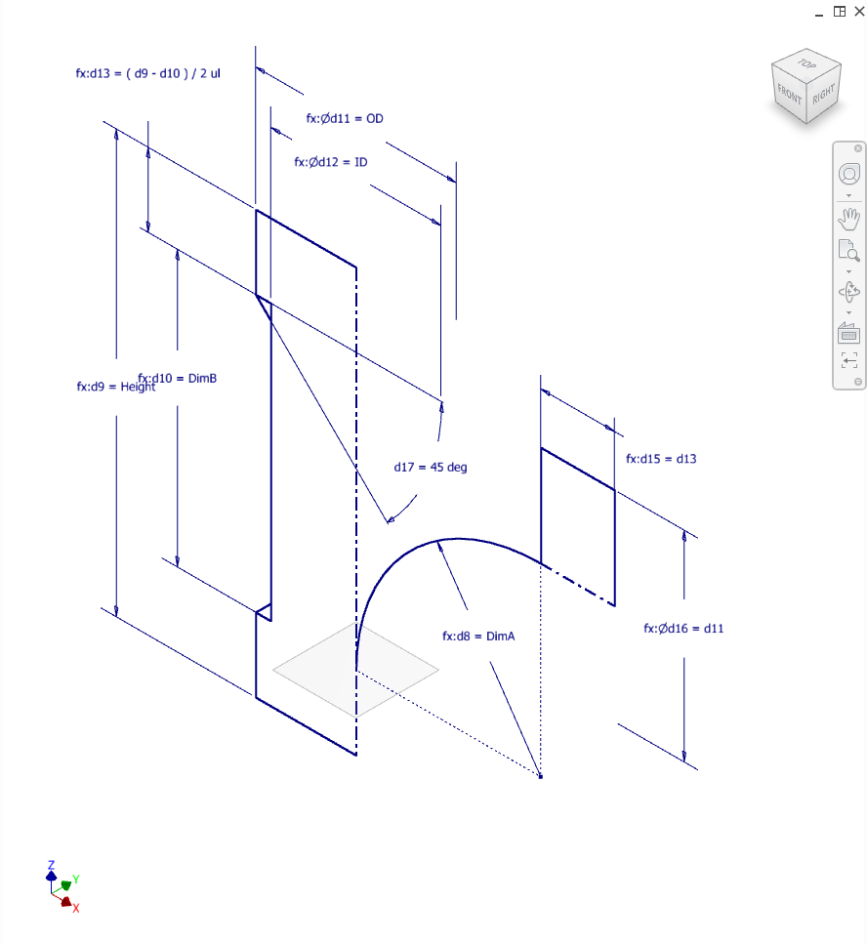
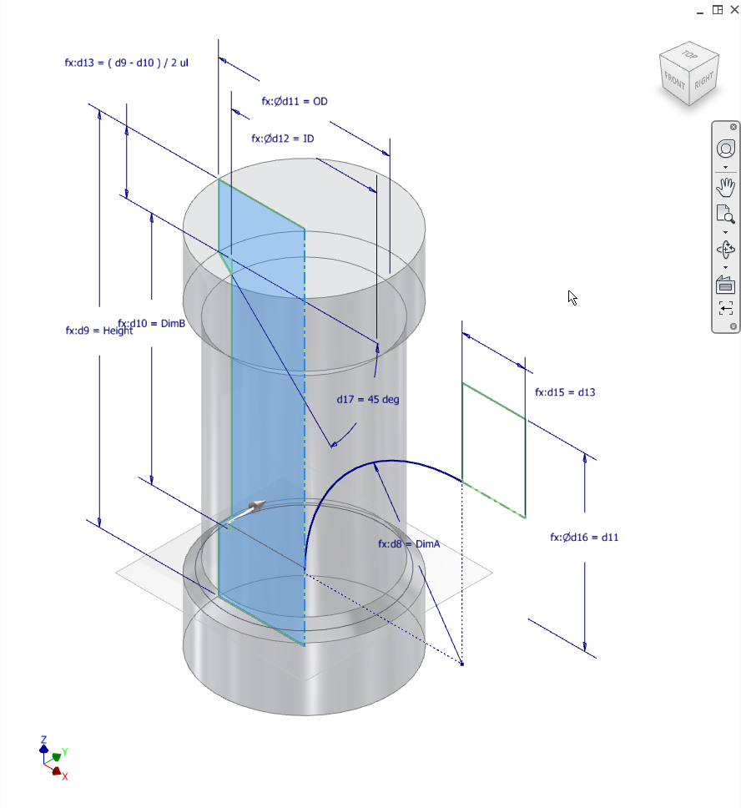
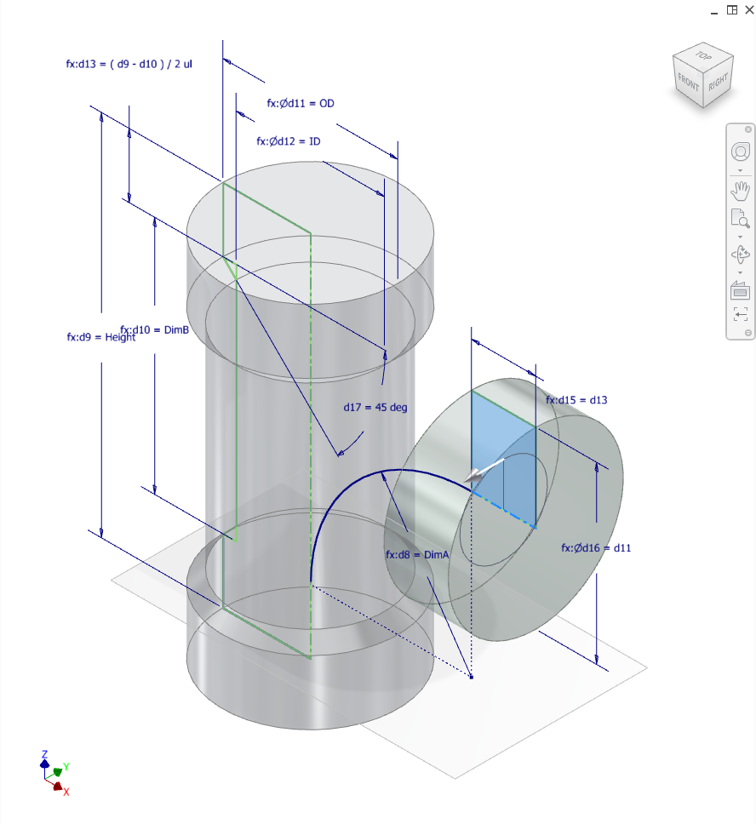
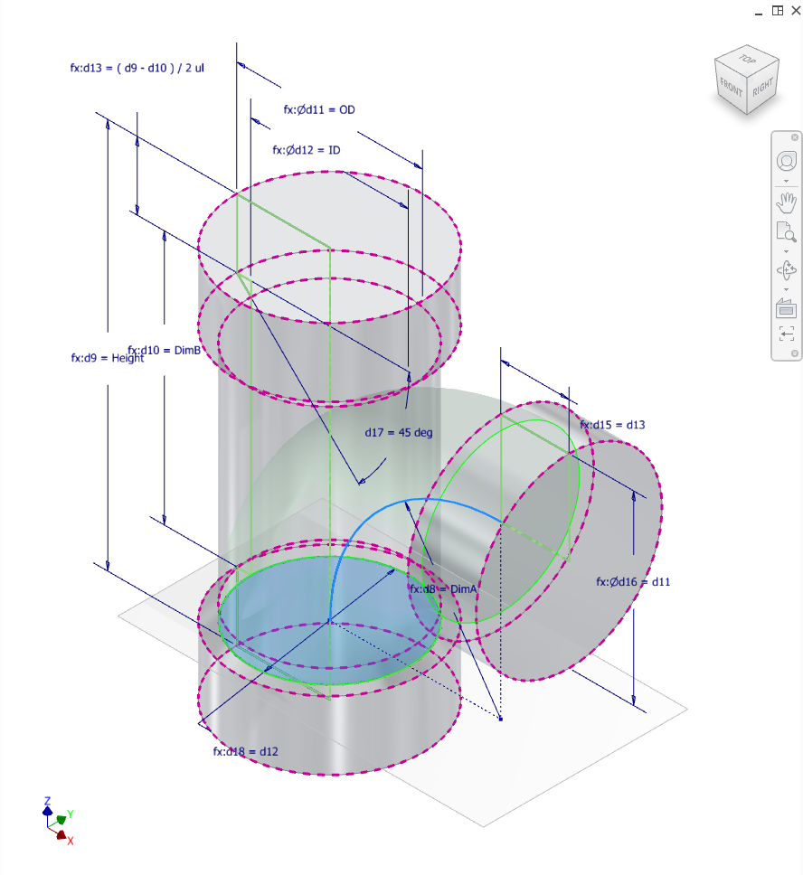
Step 3-6: Creation of volumes
Tube by Revolve feature
Socket by Revolve feature
Connection by Sweep feature
Wall by Shell (out) feature

Slide 6
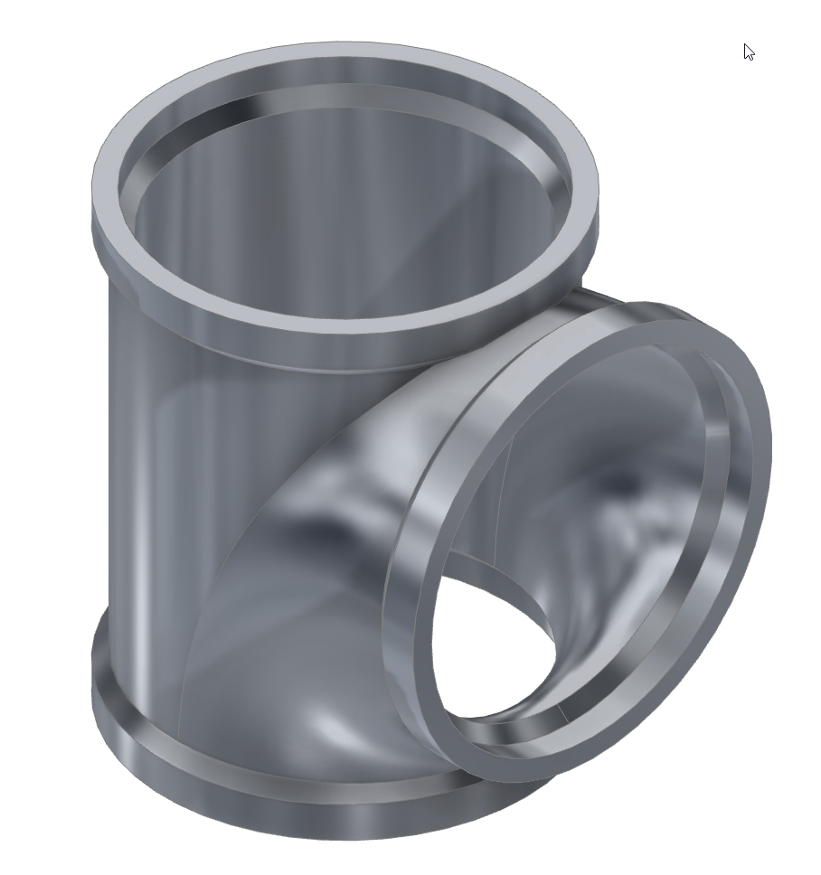
Step 7: Definition of the component family
Definition of model states with an Excel sheet
Test whether variants work

Slide 7
Thank you for your attention
Questions?

