Slide 1
Top-down design strategy for Autodesk Inventor
The Methodological Principles of 3D CAD Modeling

Slide 2

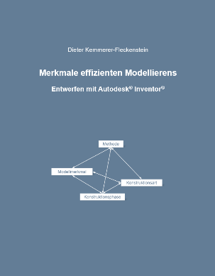
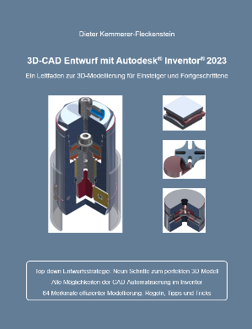
About Me: Education & Career History
Education
Technical designer (YMOS)
Degree in Mechanical Engineering from the Technical University of Darmstadt (majors: design methods, machine tools)
Design management (Steinbeis Foundation)
Career History
Technical designer (YMOS)
Development Engineer (Trumpf, Kreuzer)
Owner of an engineering office (product development & custom machinery)
Design and Development Manager (AMADA WELD TECH)
Autodesk Inventor user since 2002
Author of technical books since 2022
Packaging from my first version of Inventor that was found while cleaning up

Slide 3
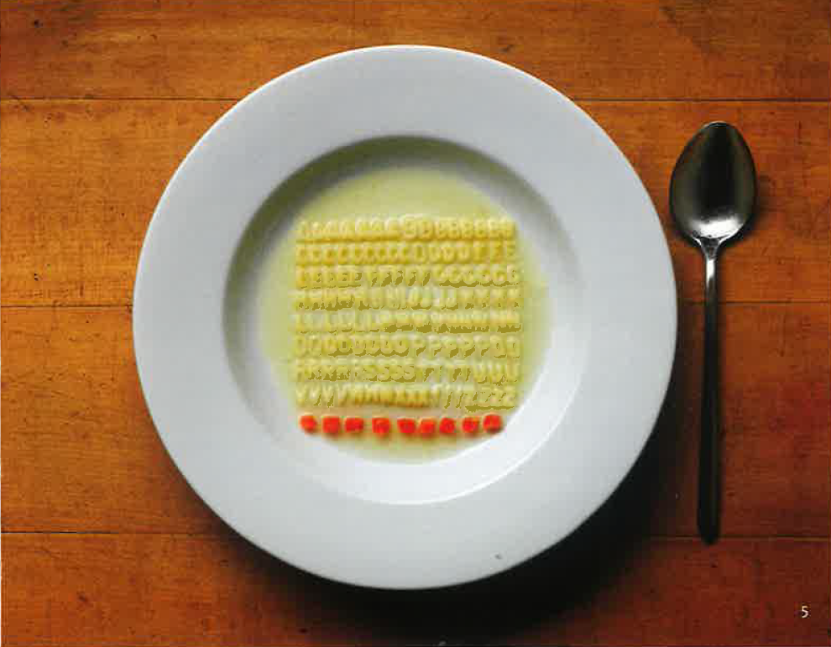

Topic and objective of the presentation
Methodological principles of modelling with AUTODESK INVENTOR
How can we ensure consistent, high-quality models? (Characteristics: Reliable, Efficient, Reusable, User-friendly)
Given Inventor’s long-standing presence in the market, the question arises as to what new insights can still be gained today.
The range of features in Autodesk Inventor, combined with the individual working styles of designers, results in model histories that vary in structure.
The starting point of this study is the assumption that general principles and rules can nevertheless be derived.
These principles are justified in this analysis.
Perhaps similar to Urs Werhli, who brings order to the chaos of a bowl of noodle soup…
Source: Ursus Werhli, Die Kunst, Aufzuräumen, Kein & Aber, 2024

Slide 4
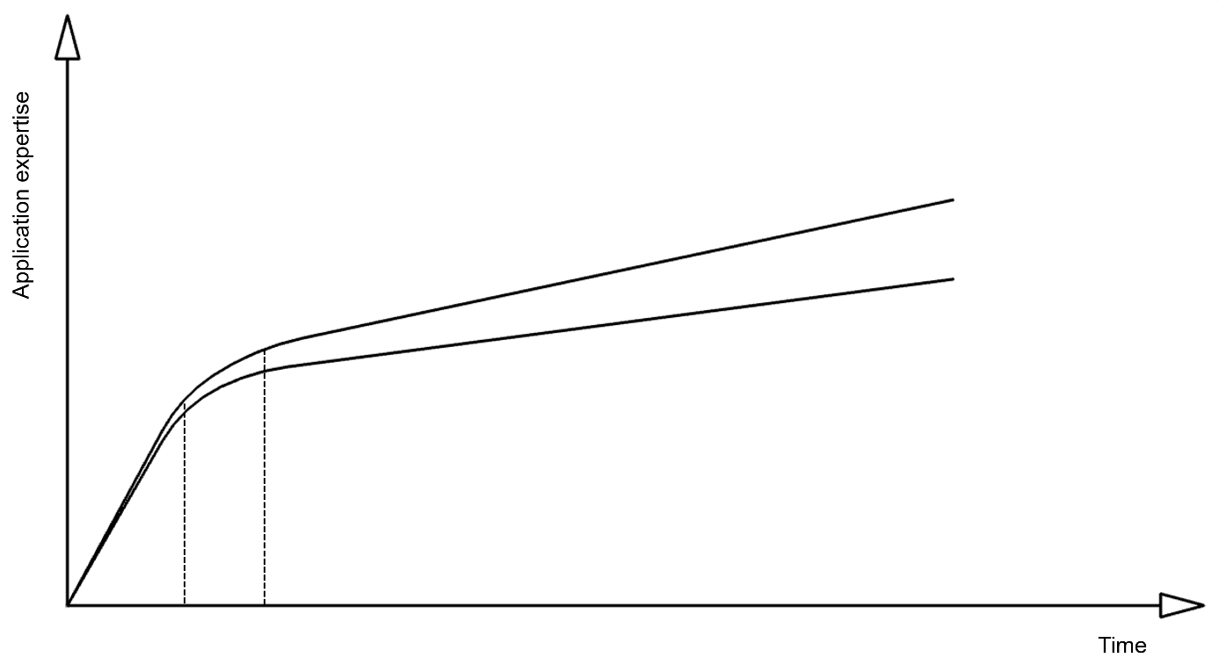
A trip into cognitive psychology: The learning curve
The Development of Application Skills Over Time
Course Content for Phase A: Fundamentals of the 3D CAD system.
Significant increase in knowledge, rapid learning curve.
The course content can be expressed in words and is therefore communicable.
Example: How do I activate a sketch plane? Click on an origin plane in the browser > Right-click (RC) > Create sketch
In cognitive psychology, this type of knowledge is referred to as declarative knowledge.
Declarative knowledge is factual knowledge.
Phase B: Beginning routine, more challenging tasks
Declarative knowledge
A
B
MuM Trainingshand-buch Autodesk Inventor Grundlagen 20xy

Slide 5
A trip into cognitive psychology: The learning curve
The Development of Application Skills Over Time
Phase C: Deepening and expanding declarative knowledge.
The learning curve flattens out.
In Phase C, another type of knowledge gains importance: procedural knowledge. This is the empirical knowledge that an experienced, engaged, and experimentally minded user has acquired over a long period of time.
Example: Declarative knowledge answers the question of how an origin plane is activated. Procedural knowledge is the answer to the question of on which origin plane the first sketch should be activated.
A lack of procedural knowledge can be recognized by frequent modification loops and messages from the Design Doctor. The 3D CAD model is unstable and can only be modified to a limited extent. Changes to the model lead to unexpected results.
Procedural knowledge is difficult to explain in words.
Publications on procedural knowledge:
Best-practice approaches
CAD didactics
Best Practices
Approaches
CAD didactics
Procedural knowledge
Declarative knowledge
A
B
C
MuM Trainingshand-buch Autodesk Inventor Grundlagen 20xy
VDI Richtlinie 2209: 3-D-Produktmodellierung
Paul Munford: Reliable Modeling Techniques for Complex Part Design in Inventor
Richard Gebhard: Resilient Modeling Strategy
Anthony Rynne: Cognitive modeling strategies for opimum design intent parametric modeling

Slide 6
Methodological principles: Theses
Procedural knowledge determines the quality of a 3D CAD model.
3D CAD models show behavior.
CAD systems do not have a button for the optimal procedure (CAD = computer-aided design: The user is responsible for designing the model).
There is one thing that all 3D CAD models have in common: the early design phase. The model’s behavior—that is, its capabilities, limitations, and thus its quality—is determined during this phase.
This highlights the need to structure the early design phase!
But what does a structured approach entail?
The core procedural skill is organizing the design phase according to the following organizational principles:
The design view
The design intent
The top-down approach

Slide 7
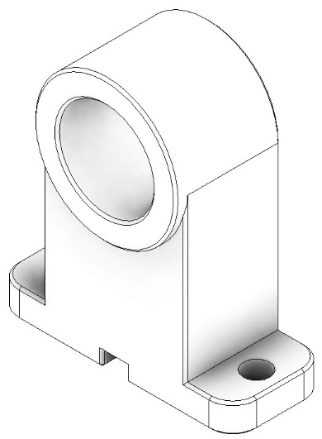
The Design View: Basics
Basic requirement: The ability to visualize a component (spatial visual representation) in three-dimensional space.
Sources: Sketches, comparable models, feasibility studies, results of creativity techniques and design methods, literature, internet research, etc.

Slide 8
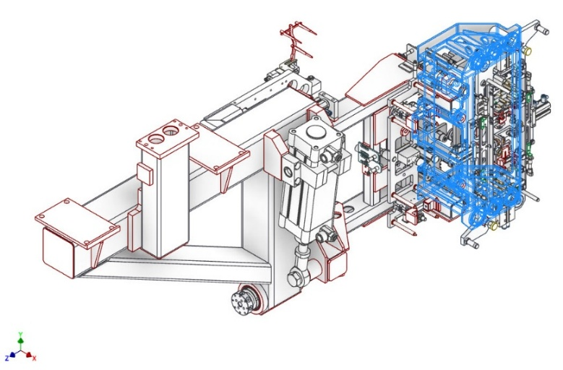
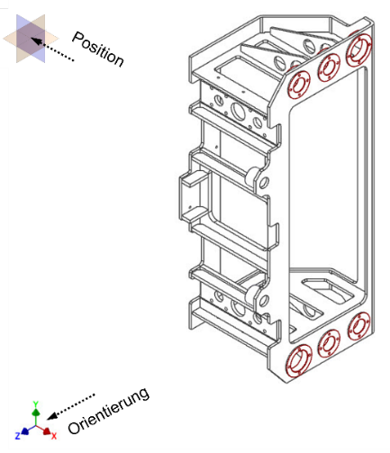
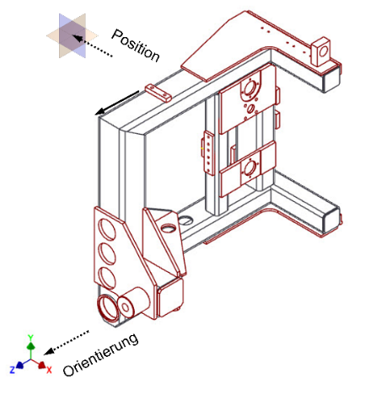
The Design View: Basics
1. Conclusion based on the spatial visual representation of the task: It follows that the orientation and position of a 3D component in three-dimensional space are known.

Slide 9
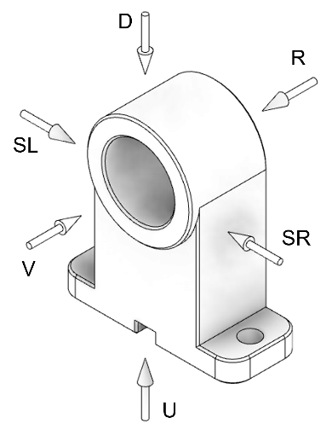
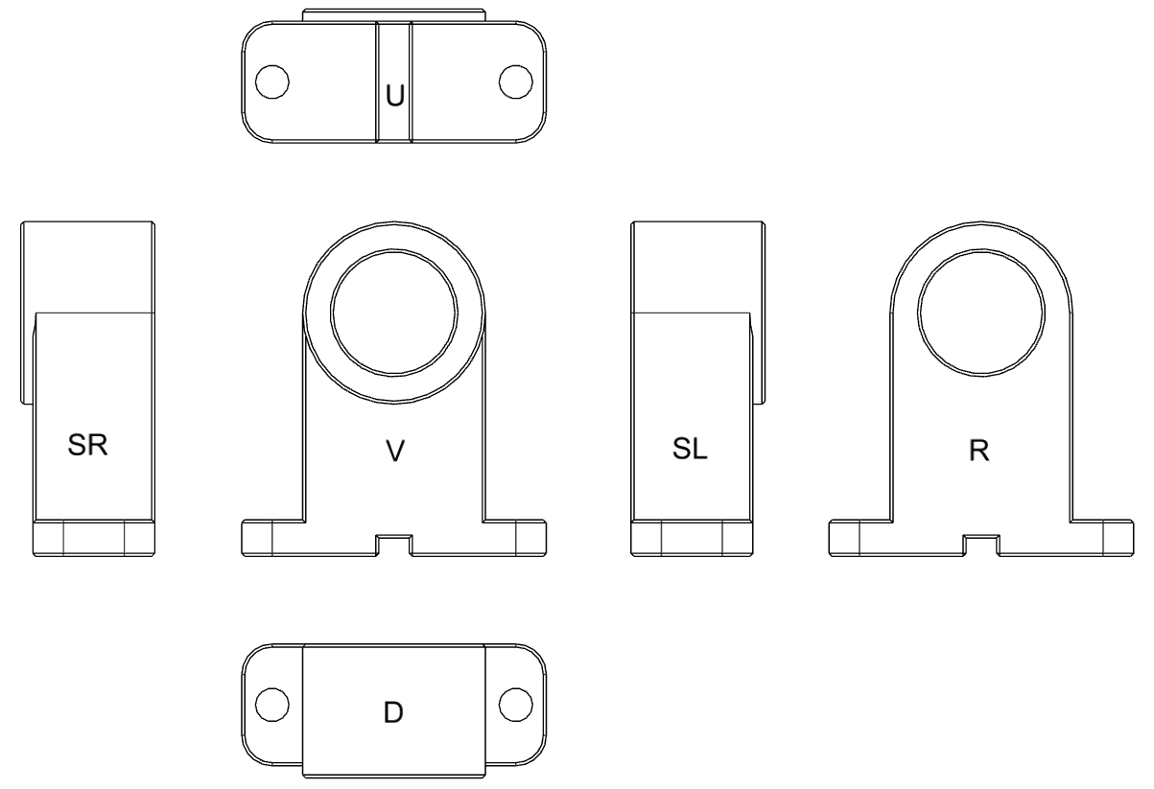
The Design View: Basics
Standard projection
The basis of every technical drawing is the standard projection.
Basic rule for representation: The front view is the view that provides the most information regarding shape and dimensions.
In 3D CAD modeling, the design view is the projection of the spatial visual concept that contains the most information.
The design view is the content of the first sketch.

Slide 10
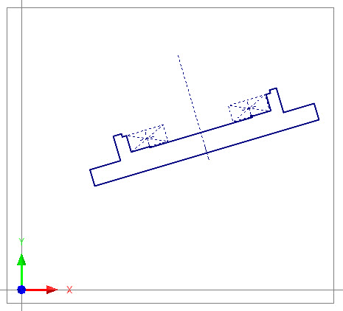
The Design View: Basics
In 2D, a sketch has 3 degrees of freedom:
2 translational
1 rotational

Slide 11
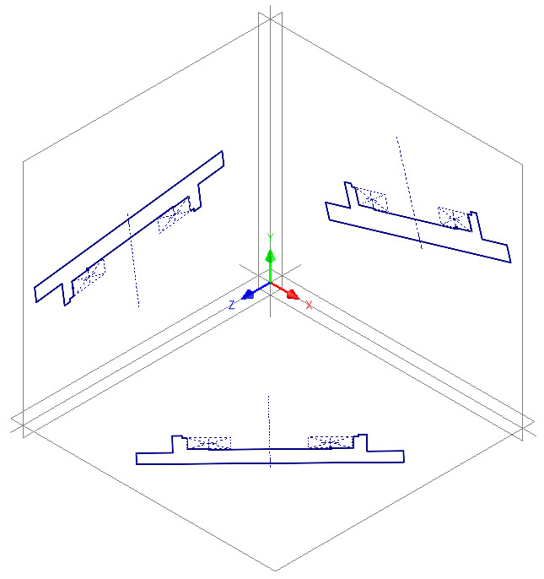
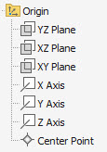
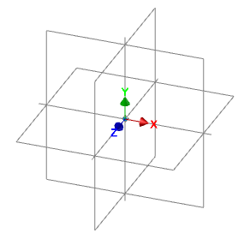

The Design View: Basics
Degrees of freedom for the first 3D sketch:
3 possible planes
Each with 2 translational and 1 rotational degrees of freedom
The three-dimensional space is displayed and controlled via the origin.
Model Browser
Origin display on the screen
Coordinate identifier
There are nine degrees of freedom for the orientation and position of the design view in the first sketch.
This raises the question of which origin plane must be activated for the first sketch.

Slide 12
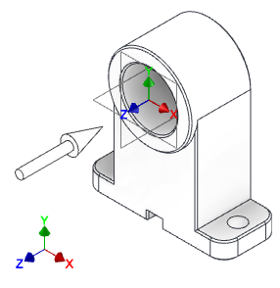
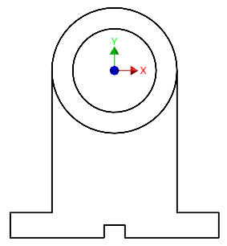
The Design View: Sketch plane for the first sketch
The component's orientation in space and the viewing direction that provides the most information are known.
2. Conclusion based on the spatial visualization of the task:
The origin plane for the first sketch is orthogonal to the projection direction of the design view—that is, the view containing the most information.
Component oriented and positioned in 3D space; direction of projection of the design view
The origin plane of the first sketch is orthogonal to the projection direction of the design view, i.e., the X-Y plane

Slide 13
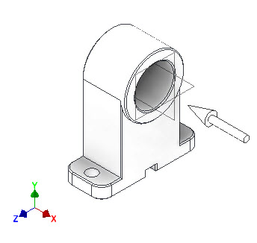
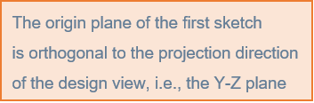
The Design View: Sketch plane for the first sketch
Another example shows the component in a new orientation, rotated 90° around the Y-axis.
The projection direction for the view containing the most information (design view) is now the X-axis.
This results in the Y-Z plane becoming the origin plane for the first sketch..

Slide 14
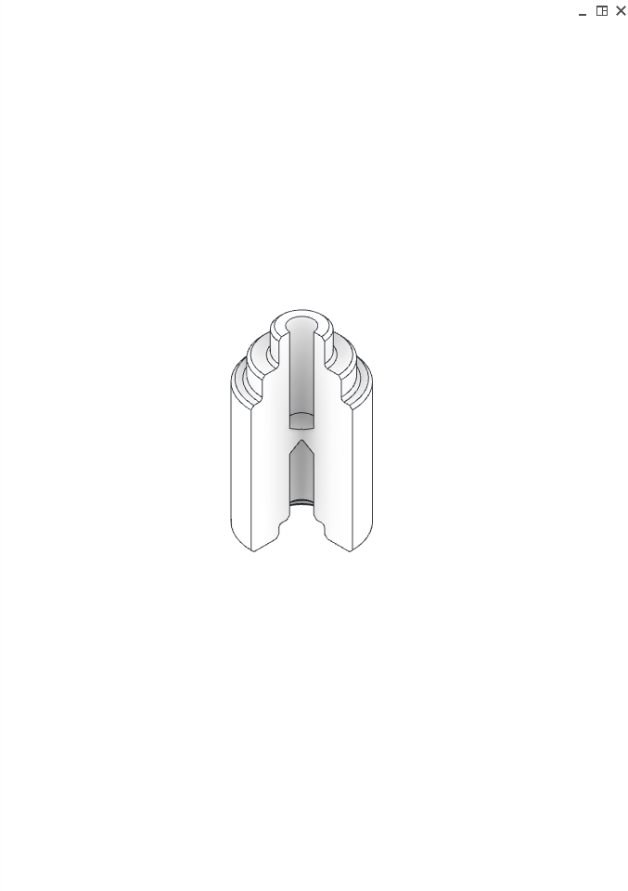
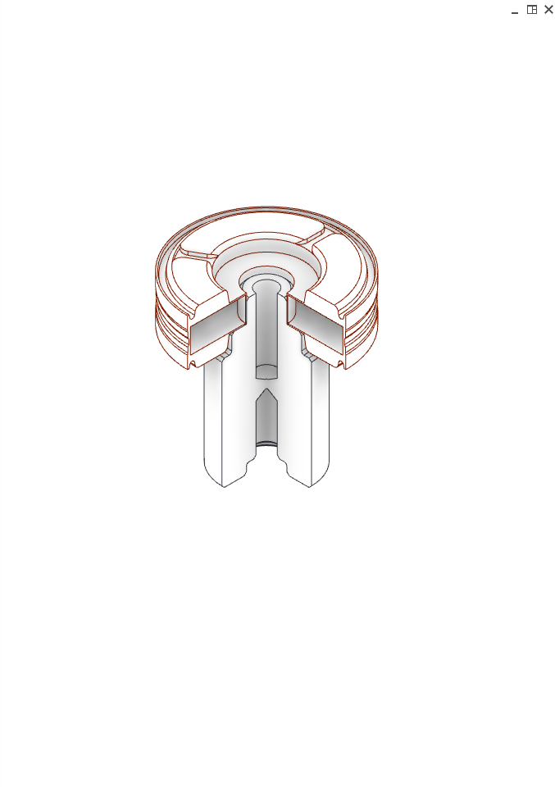
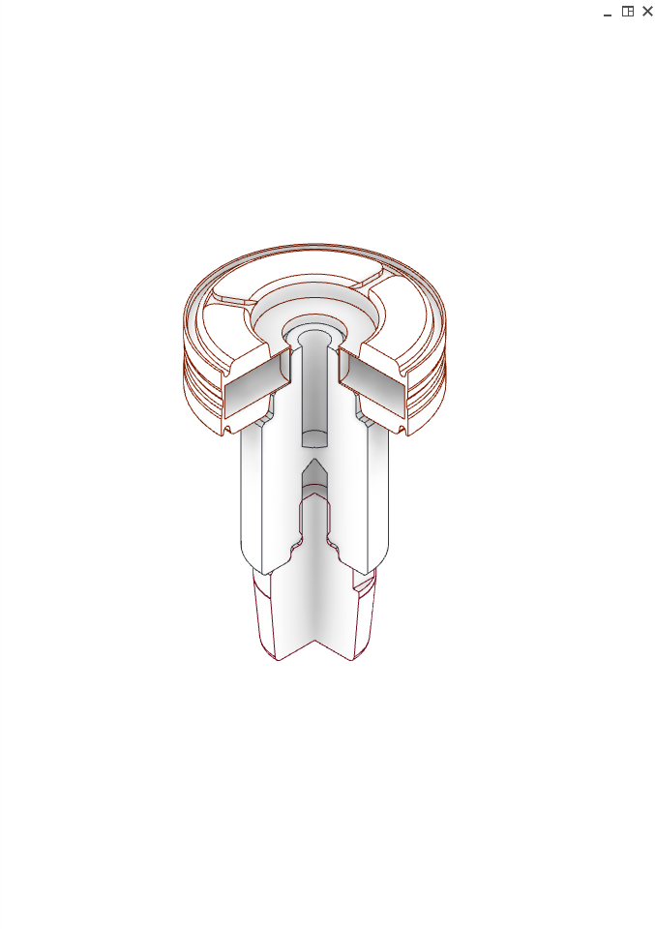
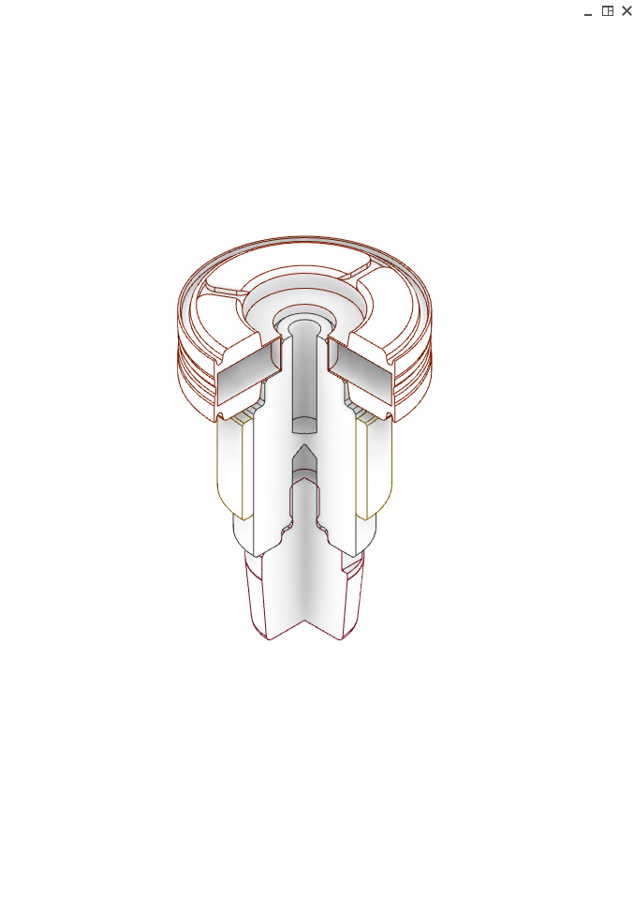
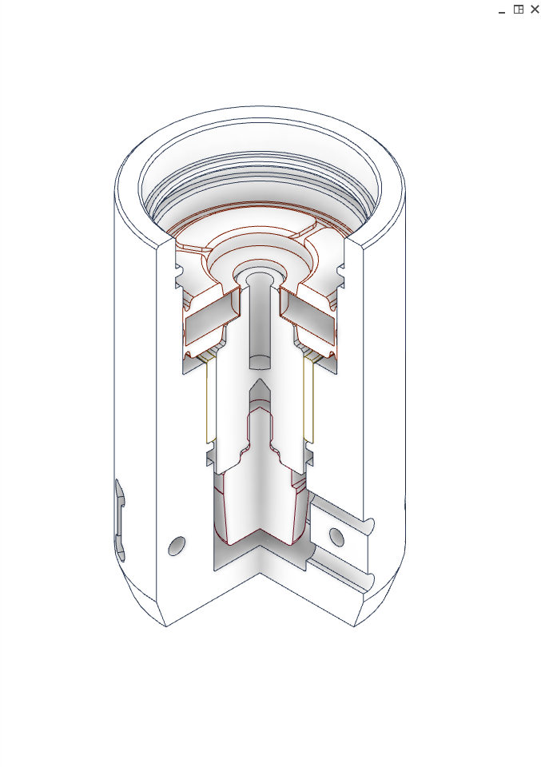
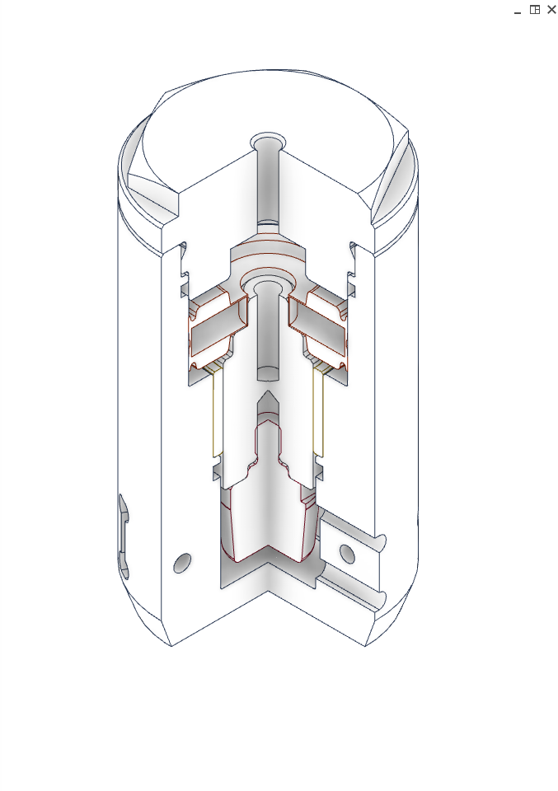
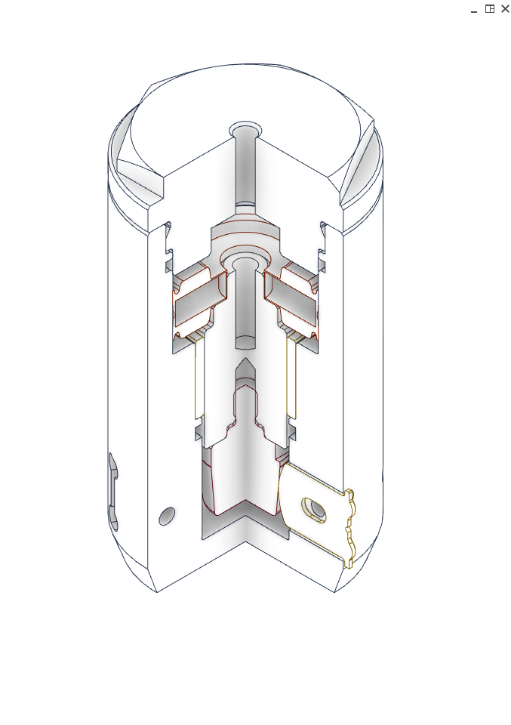
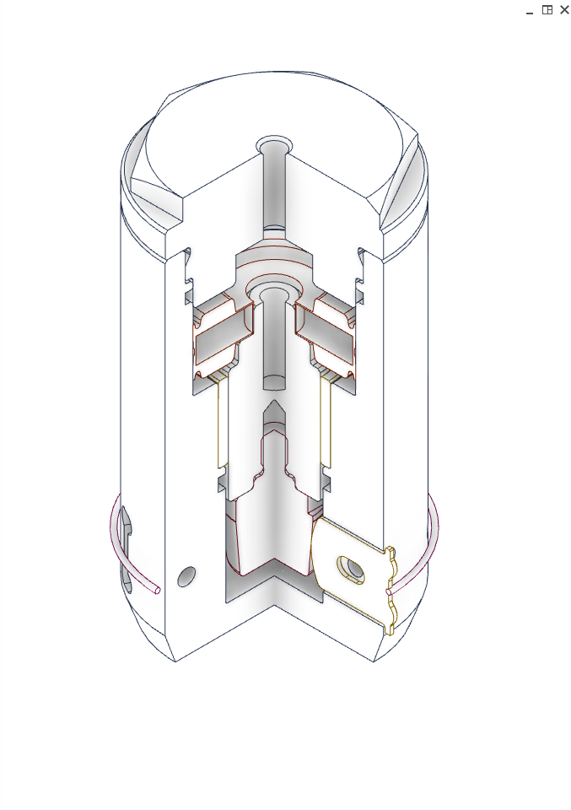
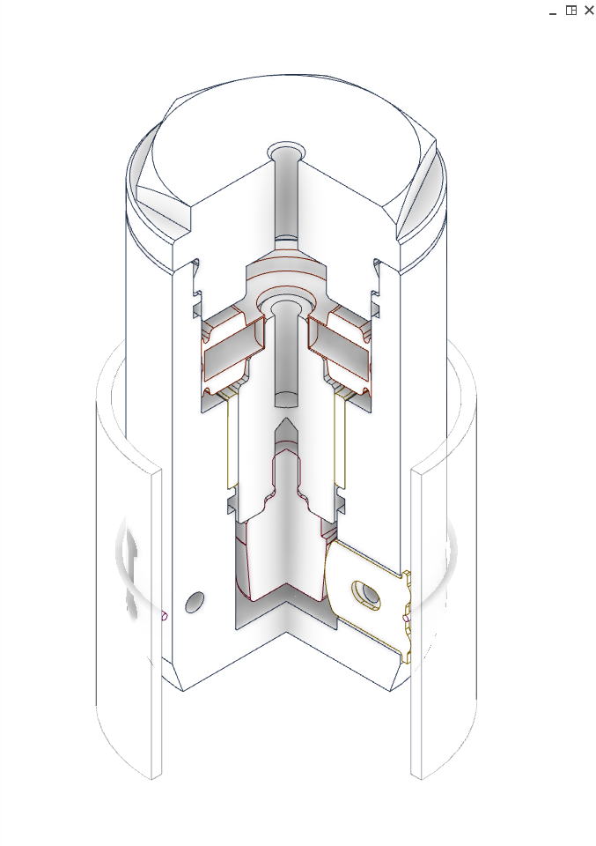
The Design View: Reference System
By strictly following this procedure, the origins of the 3D CAD components are identical, i.e., consistent.
Once the consistency of the origins of a assembly's components is ensured, they can be placed automatically. They know their position and orientation!
The corresponding Inventor feature is the “Ground and root” dialog: This command links a selection of components in an assembly to the browser's origin node.
B.O.R.N. Technologie: Base Orphan Reference Node.
This representation means that the base reference node is an orphan, meaning it has no parents and therefore no history. It is independent and cannot be deleted. This ensures that any reference to its parent elements remains stable.

Slide 15
The Design View: Consistent Origins
Advantages of consistent origins:
Clear, simple, fast, precise, and stress-free placement of 3D CAD components.
Components can be placed as placeholders without geometric content (enabling early placement).
Clear, simple, and fast replacement of components.
Independence from part surfaces and adjacent components (deletion or replacement).
Fast and unambiguous creation of sub-layouts.
Component motion positions can be defined and simulated as early as the initial design phase.
Relationships to the origin are never compromised, as it cannot be modified.
B.O.R.N.

Slide 16
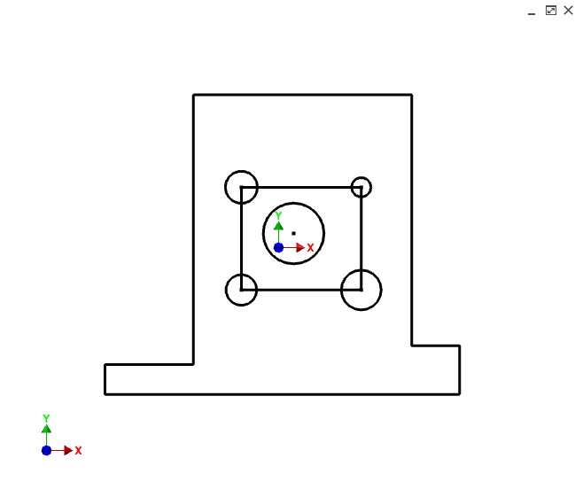
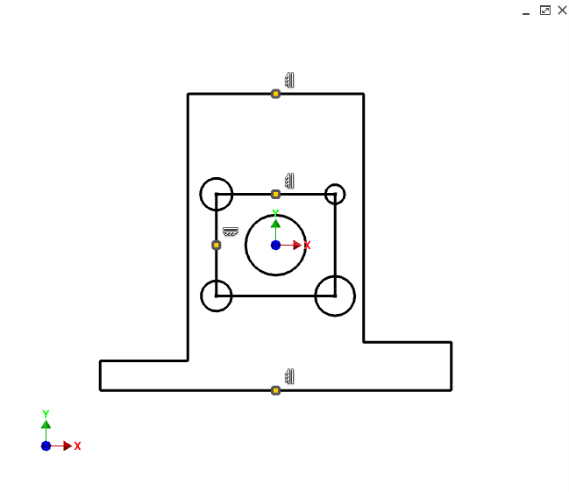
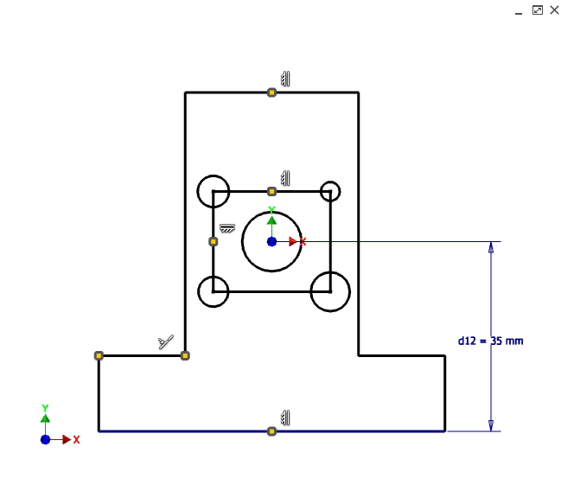
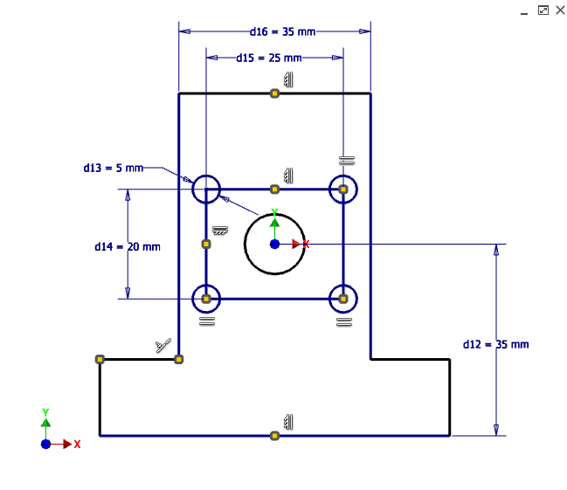
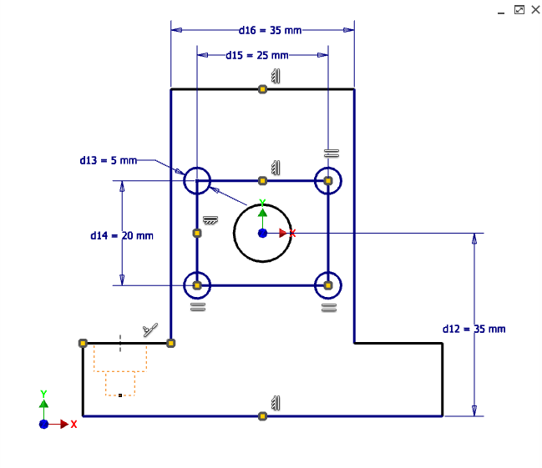
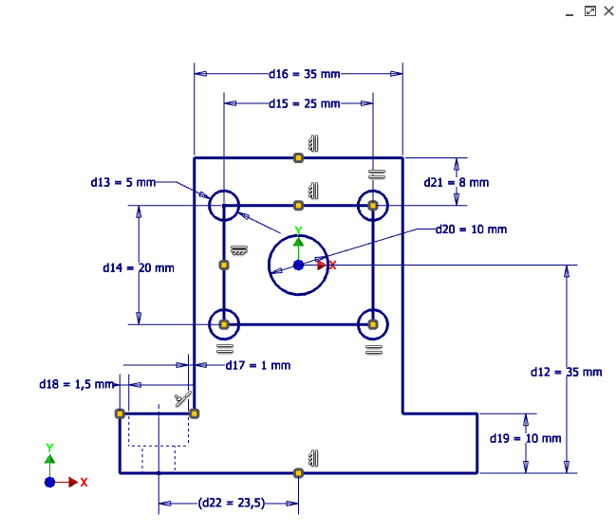
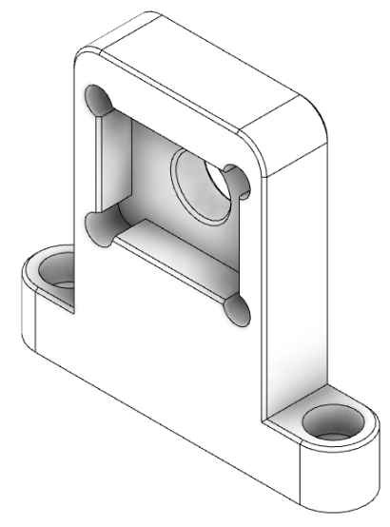
The design intent
1. Sketch with design view
Defining the design intent.
Objective: Predictable behavior of the sketch following changes. This applies, for example, to the following aspects:
Orientation and position relative to the origin.
Defining the external shape of the profile.
Determining the dimensions of the design view.
The position of features within the profile.
Geometric constraints between lines, such as symmetry, parallelism, orthogonality, and collinearity.
Relationships between geometric elements.
Taking constraints into account.
Etc.
David Martin
Design Intent in Creo Parametric

Slide 17
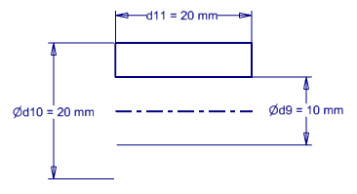
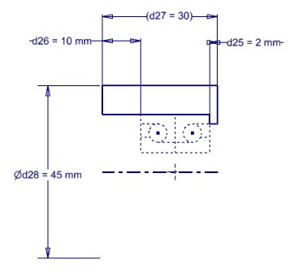
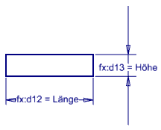
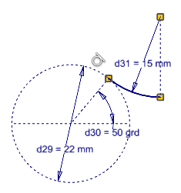
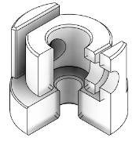
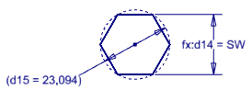
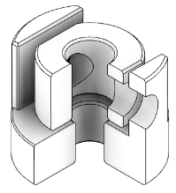
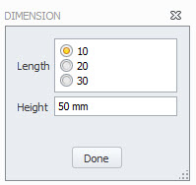
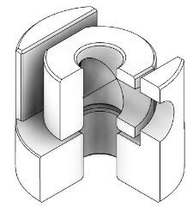

The design intent
Techniques for determining design intent
Constrains
Parameters:
Model parameters
User parameters
Reference parameters
Linked parameters
Multivalue parameters
Dimensioning concept
Construction and center lines
Blocks
Features
iLogic
Table-driven components
Combination of techniques

Slide 18
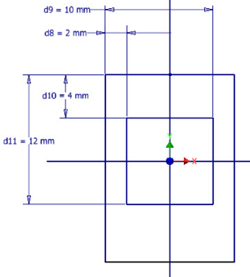
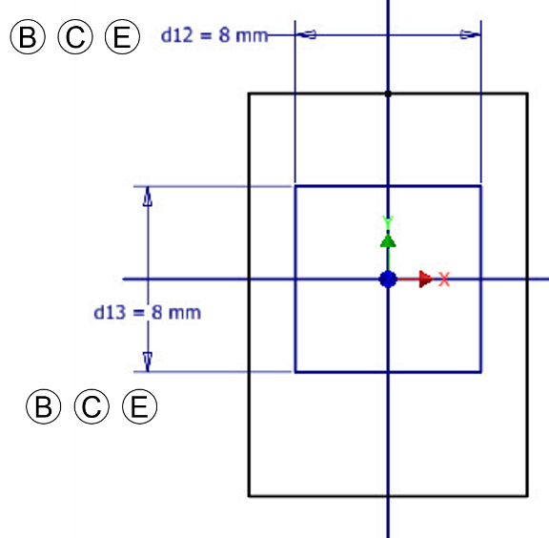
The design intent
Dimensioning Concept
Parameterizing a sketch is not the same as dimensioning a drawing.
Disadvantage of chain dimensioning in a drawing: the accumulation of tolerances.
Advantage of chain dimensioning in a sketch: the dimensions of objects remain independent of one another.
The purpose of parameterization: to ensure that important settings are not lost after changes are made. The following requirements must be taken into consideration:
Complete parameterization
Prefer chain dimensioning (instead of parallel dimensioning)
Ensure origin reference
Independent dimensioning of shapes (closed profiles within the sketch)
Ensure functional aspects (e.g., wall thicknesses)
Use symmetries
Generate reference parameters for following operations

✓

Slide 19
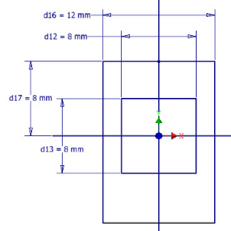
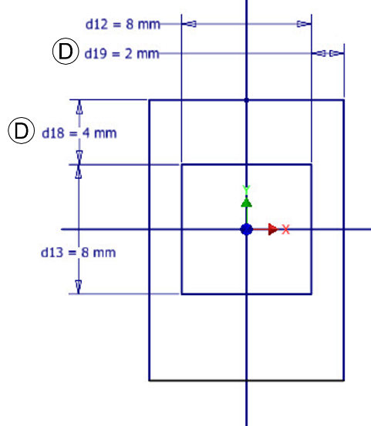
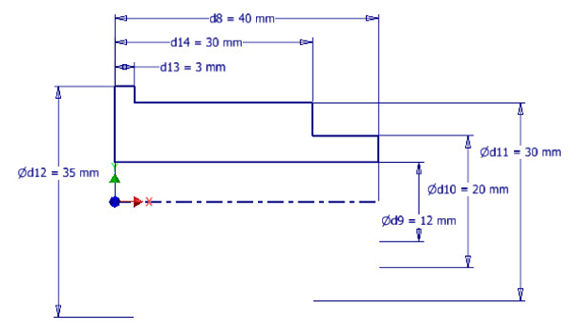
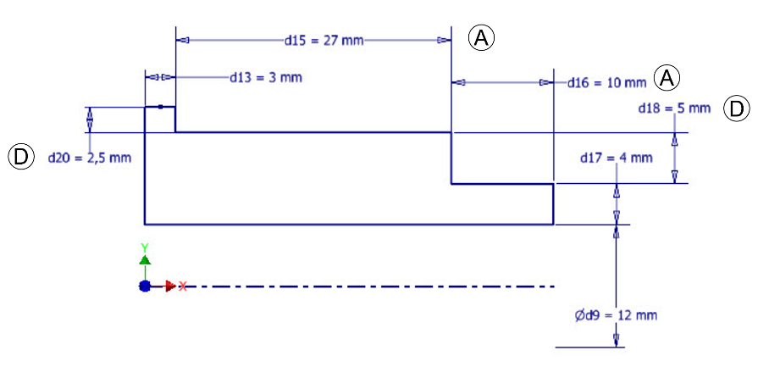
The design intent
Dimensioning Concept
Complete parameterization
Prefer chain dimensioning (instead of parallel dimensioning)
Ensure origin reference
Independent dimensioning of shapes (closed profiles within the sketch)
Ensure functional aspects (e.g., wall thicknesses)
Use symmetries
Generate reference parameters for following operations

✓
✓


Slide 20
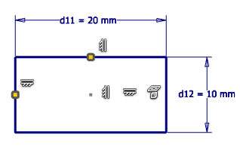





The design intent
The combination of methods for determining design intent always results in a number of approaches that lead to the same goal.
Parameters ensure quick access. However, they increase complexity.
Some constrains are difficult to edit.
Working with construction lines reduces the number of modification cycles and increases the precision of a sketch by considering the available information.
Reference parameters are useful for reuse and control.
The concept of dimensioning and defining constraints can be modified at any time in the event of unexpected behavior during changes.
Centers horizontally and vertically at 0,0
Dimensioning with 0.0 as the reference
Diagonal midpoint at 0,0
Line centers coincident with projected planes
Symmetry to projected planes
Construction line between the midpoints of the lines; the midpoint of the construction line coincides with (0,0)

Slide 21




Top-down approach: (An attempt at) a definition
Top-down: Approach based on linguistic meaning:
The term refers to both a location (“Top”) and a direction (“Down”).
The top-down approach focuses on the information relevant to model development (e.g., geometric features, parameters). The following aspects can be distinguished:
Information available before modeling. “Top” refers here to the starting point of the design, i.e., the information status.
Information that is reused. For example, neighboring components share common boundaries and therefore certain information. “Down” refers to the reuse, inheritance, or linking of information.
From a top-down perspective, the question is: What information is available, and how can it be reused?
The term “top-down approach” means much more than, for example, what is generally understood by the term “skeleton modeling.”
David Martin
Top down with Creo Parametric

Slide 22



Top-down approach
Sources of information:
Concepts: Sketches, projections, cross-sections, sections
Geometric information: Interference contours, installation space limits, planes, working area
Data from specifications, such as stroke lengths, distances
Handling object (customer product model): Typical for specialised machines.
Supplier model: Guides, drive train,
Standards: Standard parts
Etc.

Slide 23


Top-down approach
Sources of information:
Task: Handling object (product model)
Mechanical concept for handling operations
Design view
+
⇩
Top-down design view

Slide 24

Top-down approach
Autodesk Inventor allows you to take advantage of the information inheritance capabilities shown in the diagram.

Slide 25






CAD-Automation
CAD automation considers the interaction between the components of a design.
Without CAD automation, redundant information is generated.
The goal of CAD automation is to reuse existing information, such as parameters or geometric features.
This enables quick and error-free modification of a draft and results in efficient structures overall.
Reuse options
At component level
Override parameters
Reuse of sketches
In a new component
By transferring information to new components, the interaction between components can be automated.

Slide 26







CAD Automation: Example of a Guide Unit
Procedure:
Create a block of the guide cross-section
Place components in an assembly
(Ground and Root)
Derivation block into the base plate, followed by extrusion
Derivation block into the slide, followed by extrusion
Cross roller guide
Block „guide cross-sectiont“

Slide 27





CAD-Automation
Importing parameters from Excel spreadsheets, linking to parameters from other components, and deriving parameters and geometric features result in numerous inheritance paths, which are illustrated here as examples.
In addition, certain special considerations must be taken into account for specific derivations:
When sketches are derived, they inherit the properties of the original system. However, they cannot be reused.
When blocks are derived, their orientation and position can be freely selected when placing the block. The block can be placed as many times as desired.

Slide 28

Top-down-design-strategy
Summary: Principles of Structured Modeling

Slide 29


Top-down approach in 2D
The description above essentially applies to the procedure in 2D as well.
The design on the drawing board began with the information that was already known.
The work on the drawing board was purely top-down!
The representation is independent of the tool
(Freehand sketch, drawing, 2D CAD drawing, 3D CAD sketch)
For many tasks, the third dimension does not provide any new information: Example: Cylindrical assemblies.
.
The ability to display a design view in a 2D layout is key to the efficiency and quality of a 3D model

Slide 30




Top-down approach: Motion position
In accordance with the top-down approach, the first components of a design are active components (directly involved in handling operations).
If they have consistent origin references, they can be placed automatically.
This allows motion sequences to be defined, tested, and presented as early as the design phase.

Slide 31












Concepts
Concept Requirements
Quick changes
Simple representation
Consideration of information status
Focus on active components: Actuators; supplier components will be added later
No details: Drill holes, chamfers, clearances
Consistent origins:
Early verification, simulation, and presentation
A top-down design strategy supports the efficient development of concepts
31

Slide 32

Top-down design strategy
CAD software does not offer any commands for creating an efficient 3D model.
The key to predictable model behavior is the use of a top-down design strategy.
This strategy maps out the logical steps of the early design phase in detail.

Slide 33
Don´t blame the software
Quelle: Richard Gebhard
Resilient Modeling Strategy

Slide 34
Thank you for your attention.
Any questions?

